Slide 1
Network Services
UBMS Stem Experience: Jurassic Park
Notes:
DNS Video: https://www.youtube.com/watch?v=mpQZVYPuDGU
DHCP Video: https://www.youtube.com/watch?v=e6-TaH5bkjo

Slide 2
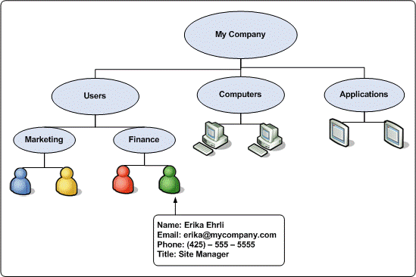

Slide 3
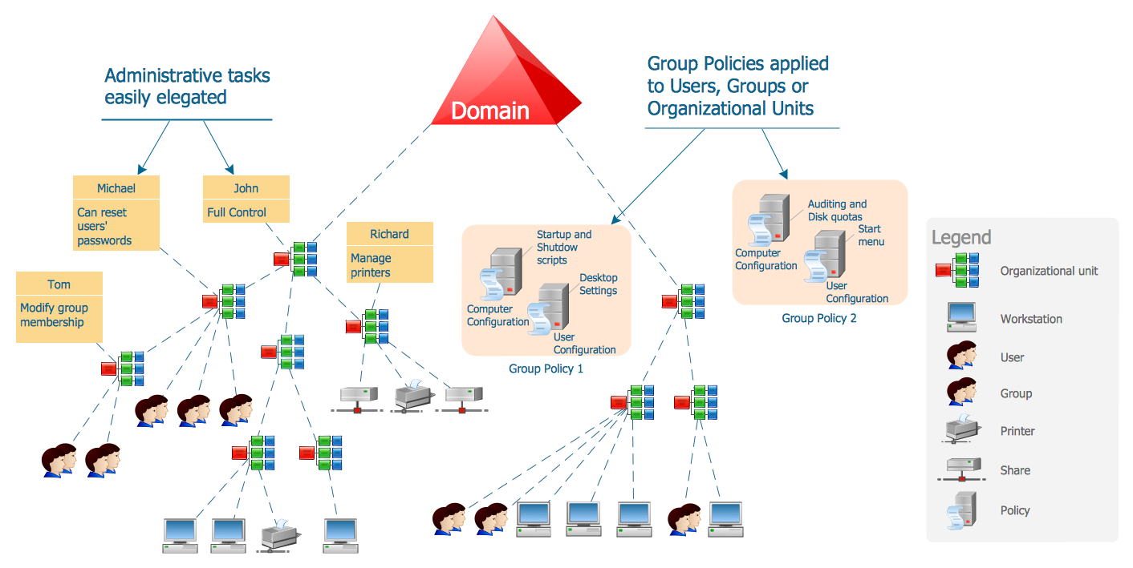

Slide 4
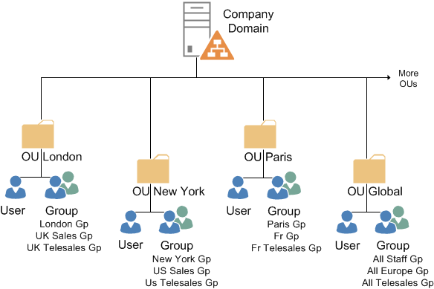

Slide 5

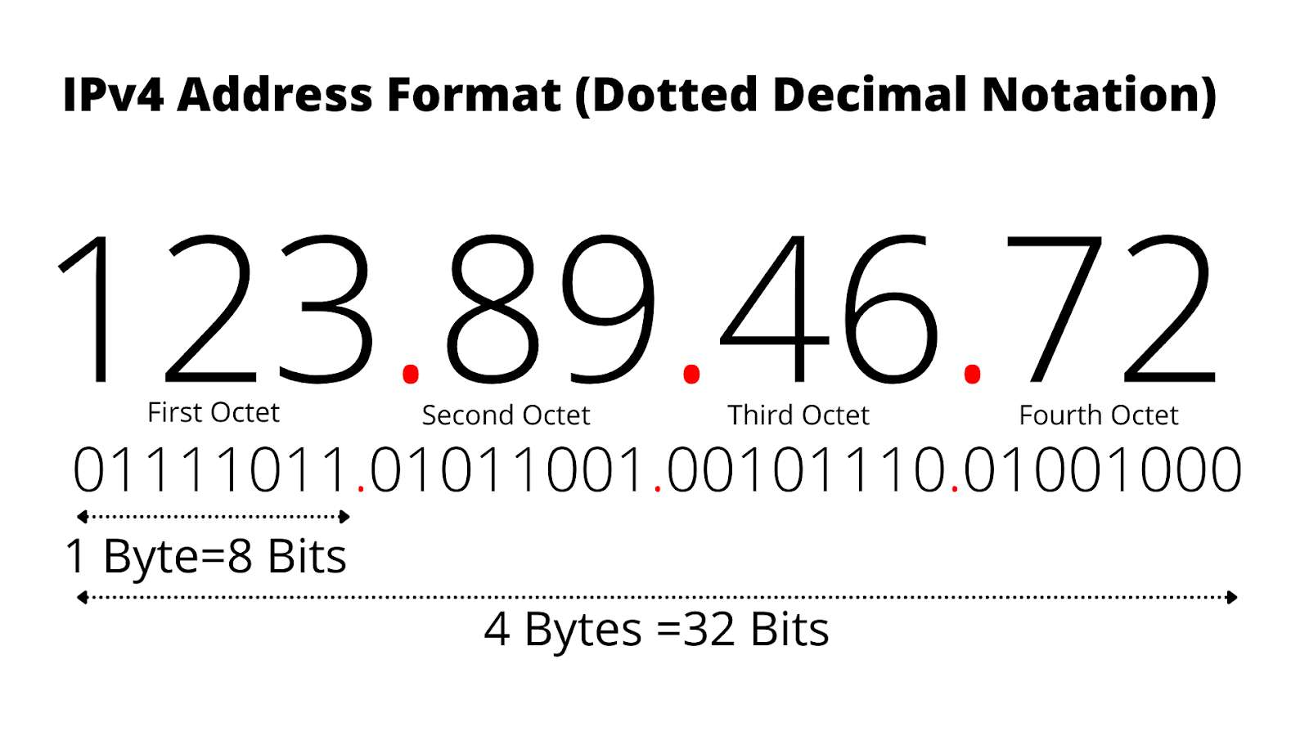
IP Addresses
IP’s are assigned to a host
An IP is made of 4 numbers separated by a period
Each number can be a 0 to 255
IP addresses must be unique inside of a network
IP addresses are how things talk to each other on the Internet

Slide 6
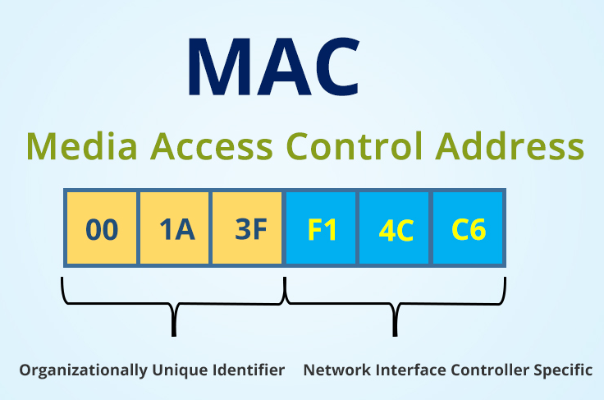
MAC Addresses
These are permanently assigned to a network card
12 Hexadecimal numbers
Hex numbers run 0-9 and A-F
The first 6 numbers are assigned to a company
Last 6 numbers are unique

Slide 7
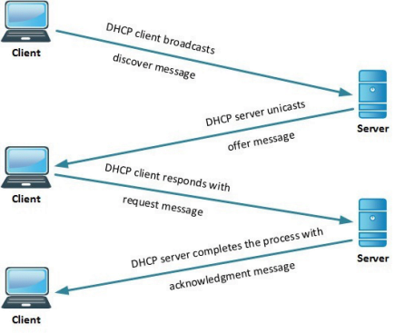
DHCP – Dynamic Host Configuration Protocol
Provides an IP address to new computers
IP addresses come out of pools
When a computer disconnects, the IP goes back in the pool
Computers are not guaranteed to get the same address when they reconnect
DHCP Server

Slide 8
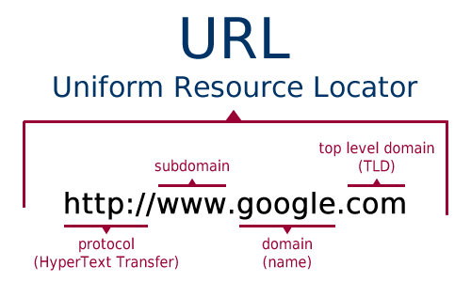
Domain Names
Web URLs are an example of using domain names to find web sites
Easy way for humans to remember addresses
Computers don’t use names, they use IPs
We need to translate from the name to the IP

Slide 9
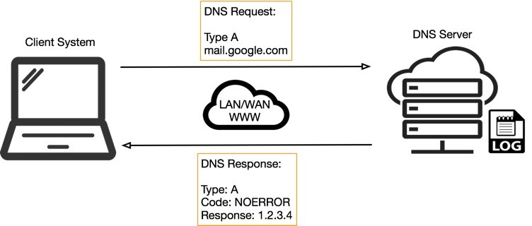
DNS – Domain Name Service
Provides name to IP address resolution
Allows the use of names that never change
Can change what IP the name points to
Used for almost all Internet communications

